Slide 1
Android App Development 101
Risa Naka, November 22, 2010
Based on CS 2046: Introduction to Mobile Application Development

Slide 2
Resources
CS 2046: Introduction to Mobile Application Development
http://www.cs.cornell.edu/courses/cs2046/2010fa/
Android Developers
http://developer.android.com/

Slide 3
Platform
Code is written in Java
Libraries available:
Standard java.* packages
android.*
UI elements
SQLite data storage
Media support (audio/video)
Access to camera, GPS, accelerometer

Slide 4
Major Components
Activity
Main component of an application
Generally visible to the user
ContentProvider
Stores data and makes it available to other apps
Service
Handles background work and ongoing tasks
BroadcastReceiver
Receives events from the phone

Slide 5
Example – Music Player
Activity
UI for browsing music, selecting songs
ContentProvider
Store the music and metadata
Gives other apps access
Music recommendation
Service
Actually plays music – supports backgrounding
Broadcast Receiver
Pause music if headphones are unplugged
Projects: Tasks

Slide 6
Example – OpenComm
Activity
UI of a private space
ContentProvider
Store the user information and metadata in SQLite Database
Gives other apps access
Service
Manipulates sound, send to mixer
Update user information
Broadcast Receiver
Notify other users once one person’s system has finished booting
Projects: Tasks
An application can access multiple projects

Slide 7
Tasks and Activities
Tasks: a stack of activities
1 Activity will start the application, and subactivities will be called by other activities
Activity that starts the event

Slide 8
Activity Lifecycle
Active: in the foreground, running
Paused: obscured by another Activity which takes up part of the screen (transparent)
May be killed if low on memory
Stopped: not visible on screen

Slide 9
Activity Lifecycle
onCreate(): Called when Activity is first created
Prepare GUI, other initialization steps.
Only method required to override
onResume(): Called when Activity is now on top of the stack.
Update GUI values
Note: This is called when Activity is first launched!
onPause(): Activity is about to disappear.
Commit unsaved data, stop any CPU-intensive tasks.

Slide 10
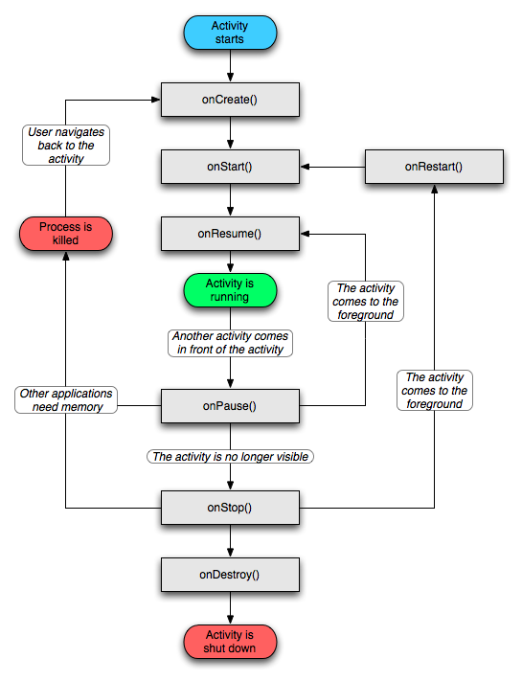
Activity Lifecycle
http://developer.android.com/reference/android/app/Activity.html

Slide 11
Example – OpenComm:: Task: Private Space
Task: put users in/out of private spaces
Activities
SpaceList
Contains a list of users and a list of private spaces
PrivateSpace
Allows users to manipulate users within a private space
ContentProvider
UserProvider: access to database with buddy info
SpaceProvider: access to database with space info
Service
BuddyService: updates buddy info through an online service
SpaceService: updates space info through an online service

Slide 12
Example – OpenComm:: Task: Sound Spatialization
Service
SoundService
Manipulates sound as it is coming into the phone
Can be accessed by the previous project
In prior project:
i = new Intent(); // create a new intent
i.setAction(Space.ACTION_SOUND_MOVE);
Space.ACTION_SOUND_MOVE is a String “opencomm.spacesound.ACTION_SOUND_MOVE”
In this project:
if (Space.ACTION_SOUND_MOVE.equals(intent.getAction()) { // do something }
Duplicate class Space exists in both projects!

Slide 13
Intents
On a desktop:
Open an application by double-clicking it
Open a file with an application
Drag file to shortcut
Specify default handler for a certain filetype

Slide 14
Intents
Abstract description of an operation to be performed
Action: the general action to be performed – what is it going to do?
Data: what should be operated on – on what data are we doing the action?
Component (optional) – what will perform the action
“The boy hits the ball”
Action: hit, Data: ball, Component: boy

Slide 15
Intents:: Interaction with other components
startActivity(Intent) – launch an Activity
broadcastIntent(Intent) – sends Intent to BroadcastReceiver
startService(Intent), bindService(intent, ServiceConnection, int) - Service

Slide 16
Intent Resolution:: Implicit vs. Explicit
Implicit: let the system determine the best component to handle the intent
Used to activate components in other applications
Explicit: designates target component by its name (ex: “cornell.cs2046.tasks”)
Used to activate subordinate services, launching sister activity
(ex: “com.example.project.app.HelloActivity”)

Slide 17
Intent Resolution :: Implicit
Compare contents of Intent object to intent filters
Allows the possibility of receiving implicit intents of the advertised type
If there are no intent filters, it can only receive explicit intents
If there are intent filters, it can receive both

Slide 18
Intents:: Examples
TaskList.java (Activity) – displays the list of tasks
TaskEdit.java (Activity) – allows user to edit different attributes a task can have
Note: this is what happens on the UI; these two alone do not provide functionality!
Within TaskList.java
Intent in = new Intent(this, TaskEdit.class);
// selects TaskEdit
startActivity(in);
// starts TaskEdit

